Slide 1
CSE :291 Exploratory Project RECOMMENDER SYSTEMS – Automatic Movie Rating Prediction Using Machine Learning

Slide 2
Submitted By :
Robin Chawla 14075046
Virat Bansal 14075058
Isha Agarwal 14075063
Under Guidance of
Prof. K.K.Shukla

Slide 3
INTRODUCTION :
Recommender systems that model users and their interests are often used to improve various user services. Such systems are based on automatic prediction of user ratings of the items provided by the service. In this work, we implemented two machine learning methods for automatic ratings prediction in the domain of movie ratings. The chosen methods are based on various approaches describes in related papers. During the prediction process both the user and item features can be used. Data was gathered from the publicly available movie database IMDb. The report encompasses the implementation of the chosen methods and their evaluation using gathered data. The results of both the methods are then compared.

Slide 4
BACKGROUND :
Automatic ratings prediction systems determine a possible user rating for a specific item using a set of chosen features.
The user ratings given to some items are used to determine the ratings of other items(movies here).
It is implemented on IMDb dataset.
Machine Learning Techniques are used.
We have used two methods :
1) Bayesian Machine Learning Algorithm
Decision Tree Machine Learning Algorithm
Bayesian Method is Collaborative-based method and Decision Tree Method is purely a Content-based method.

Slide 5
BAYESIAN METHOD (Personality Diagnosis) :
With the growth of Internet commerce, the use of collaborative filtering (CF) algorithms in recommender systems has grown.
The goal of collaborative filtering (CF) is to predict the preferences of one user.
It is a Collaborative based method.
Given a user's preferences for some items, we compute the probability that he or she is of the same "personality type" as other users, and, in tum, the probability that he or she will like new items.
It is a Personality Diagnosis Method.

Slide 6
The personality diagnosis method models a user’s personality and uses it in the prediction of ratings.
If there are m movies in total, the personality type of user i can be presented as a vectorR^{true}i= <R^{true}i1 ,R^{true}i2 , . . . , R^{true}im>,
where ratings R^{true}ij represent “true” ratings of movie j for user i.
For user i and movie j, the recorded rating presents a realization of a random variable, governed by a normal distribution, whose mean value is equal to the “true rating R^{true}ij:
It is assumed that the personality types follow normal distribution property.
The user u for which the prediction is being made can belong to any of the observed personalities R1, . . . ,Rn with a probability of 1/n. Knowing some of the ratings of user u, the probability that he belongs to the personality type Rican be calculated by:

Slide 7
The probability distribution of the rating for movie i and the current user u can be estimated using previous probabilities for personality types as follows:
The rating with the highest probability is then the predicted rating of user u for movie i. The method is defined only with the deviation σ of the normal distribution.

Slide 8
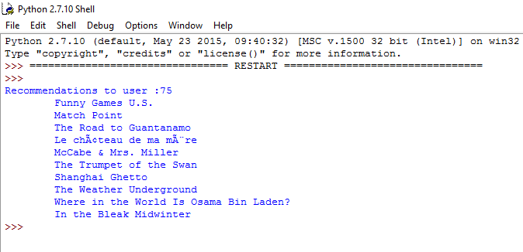
Bayesian Method Result :
The screenshot below shows the recommendations made to a specific user (User No-75):

Slide 9
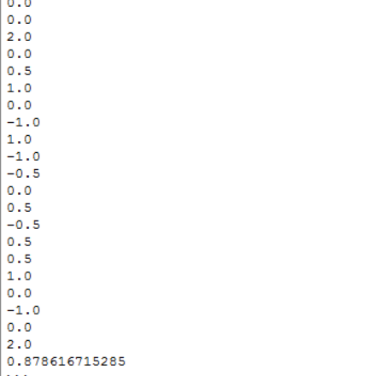
The screenshot on shows the root mean squareerror is 0.8786167.

Slide 10
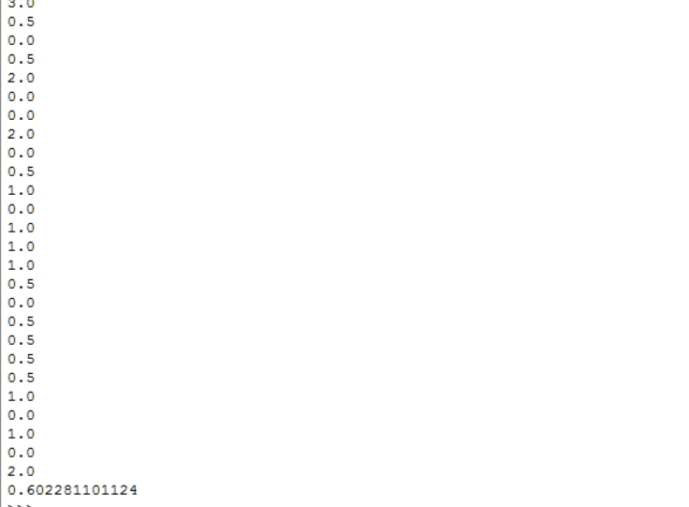
The screenshot below shows the absolute error = 0.6002.

Slide 11
DECISION TREE :
Decision tree is a Content-based filtering approach which recommends items based on the comparison between item attributes and user preferences.
The attributes of the movie used in this paper are: Genres, Actors, Directors and Movie Location. User profile is represented by the decision tree created for each user.
Decision Tree is the supervised learning algorithm which is used for classification and regression.
The goal is to create a model that predicts the value of a target variable by learning simple decision rules inferred from the data features.
Tree models where the target variable can take a finite set of values are called classification trees.
Inbuilt Implementation of DecisionTreeClassifier from the scikitlibrary(in Python) is used.

Slide 12
The goal is to create a model that predicts the value of a target variable based on several input variables.
Each interior node corresponds to one of the input variables; there are edges to children for each of the possible values of that input variable.
Each leaf represents a value of the target variable given the values of the input variables represented by the path from the root to the leaf.
DecisionTreeClassifier is capable of both binary (where the labels are [-1, 1]) classification and multiclass (where the labels are [0, ..., K-1]) classification.
DecisionTreeClassifier takes as input two arrays: an array X, sparse or dense, of size[n_samples, n_features] holding the training samples, and an array Y of integer values, size [n_samples], holding the class labels for the training samples.
After being fitted, the model can then be used to predict the class of samples.
Ratings are predicted and the movies are recommended accordingly.

Slide 13
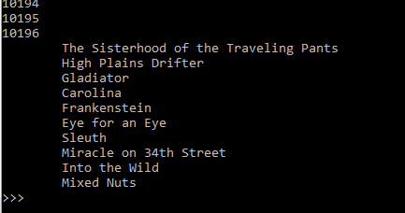
Decision Tree Result :
The screenshot below shows the recommendations made to a specific user (User No-75):

Slide 14
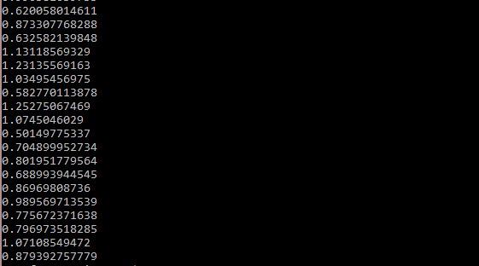
The screenshot below shows the absolute error of 0.8793 approx. 2000 users(without
varying the random variable)
The absolute error for one user when we iterate the random variable from 1 to 1000 = 0.46.

Slide 15
CONCLUSION :
The Bayesian method (Personality Diagnosis) and Decision Tree method (classification) were implemented and their corresponding errors were calculated. Our next goal will be to implement to calculate the absolute error in Decision Tree for approx. 2000 users by iterating the random variable from 1 to 1000. Further we will implement Neural Network Method and then compare the results.
The link to the whole code of the project on Githubis :https://github.com/IshaAg/Recommender-Systems---Automatic-Movie-Ratings-Prediction-using-Machine-Learning.git

